Slide 1
Data Transform
2020/12/8
Speaker：Jun-Tsung Wu
Advisor：Prof. Tong-Yu Hsieh

Slide 2
Outline
Check data format and missing values in hr_analytics.csv an titanic_train.csv.
Numeric vs Text
Fill in the missing values
How to transform the data if data format is word.
Using different feature data to observe the predict result.

Slide 3
Hr_analytics

Slide 4


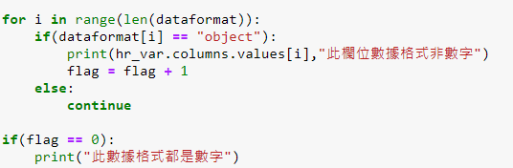
Check Data Format
Using name_df.dtypes and for loop.
Print the result like picture below.
Hint
len(x) : length of x
range(Y) : number 0 to Y-1
The Xth column name
name_df.columns.values

Slide 5
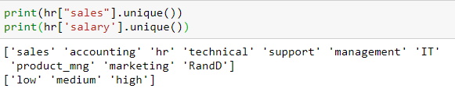
Data Transform(1/3)
Check the “sales” and ”salary” column values.
name_df[“column_name”].unique()
Check the number of kinds of values in columns.
name_df[“column_name”].value_counts()

Slide 6
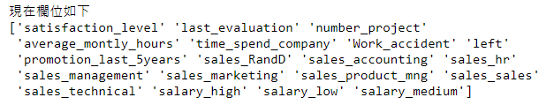
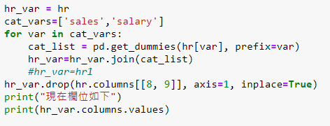
Data Transform(2/3)
Merge values with less number of kinds or the same type.
Use .get_dummies() to convert text to numbers.

Slide 7

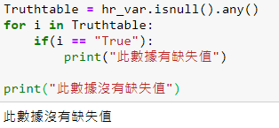
Data Transform(3/3)
Check the format again.
Check the missing values.

Slide 8
Observe the predict result
Merging different kinds of data in “sales” columns to observe the result.
Ex:
And then check the result.

Slide 9
titanic

Slide 10
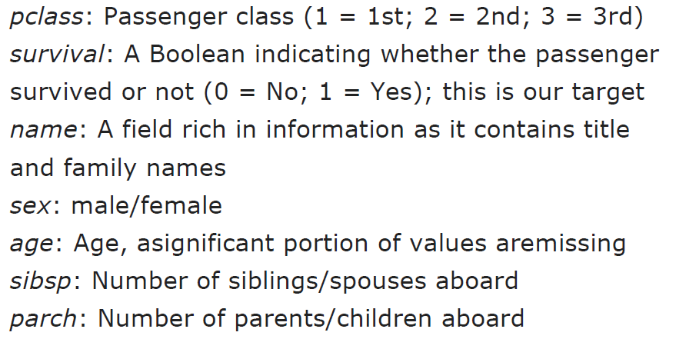
Column Description(1/2)
Target : survival

Slide 11
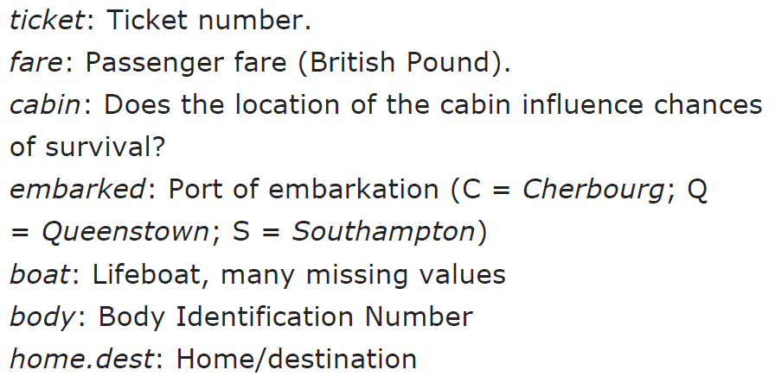
Column Description(1/2)
Target : survival

Slide 12
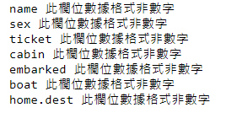
Check Data Format
Using name_df.dtypes and for loop.
Print the result like picture below.
Using the same method.

Slide 13
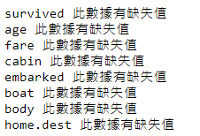
Check Missing Values
Using the same method.

Slide 14
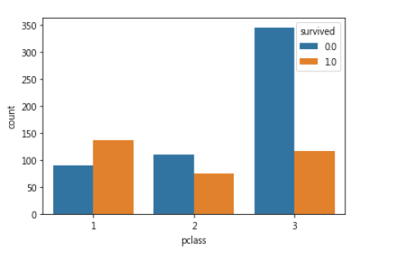
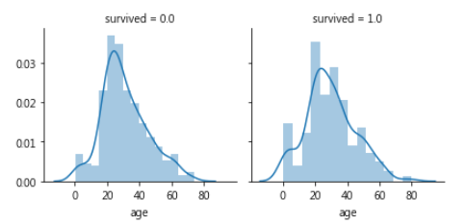

Observe Data
sns.countplot(data[‘column_name'], hue=data['survived’])
survived
pclass
sex
Embarked
Another plot

Slide 15
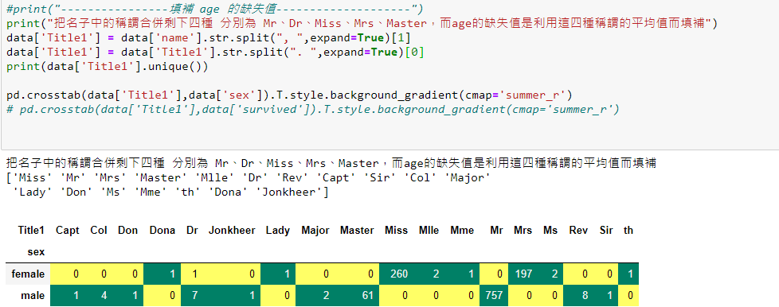
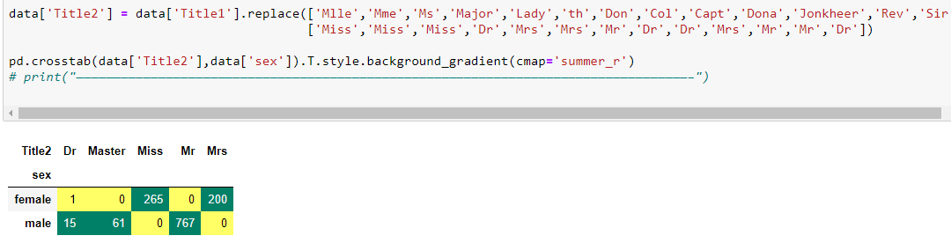
Fill in Missing Values(1/4)

Slide 16


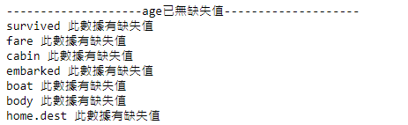
Fill in Missing Values(2/4)
Use mask and loc to select the columns and values.

Slide 17
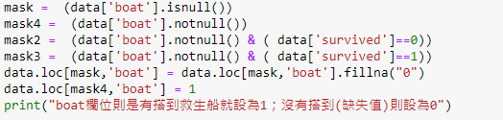
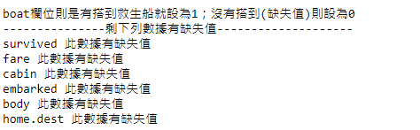
Fill in Missing Values(1/4)
Check boat data

Slide 18
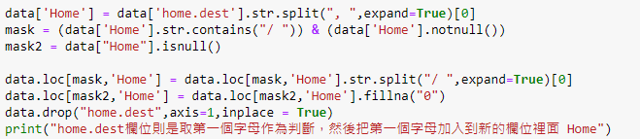

Fill in Missing Values(1/4)
Check home.dest data
You will check the remain data in your homework.

Slide 19
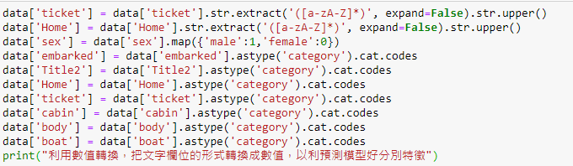

Oneshot Method
Check non-numeric data

Slide 20
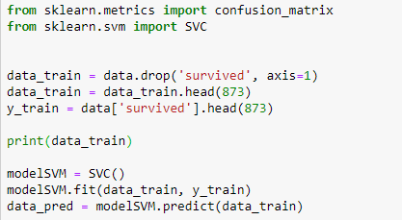
Predict the Survival(1/2)
Use SVM model

Slide 21
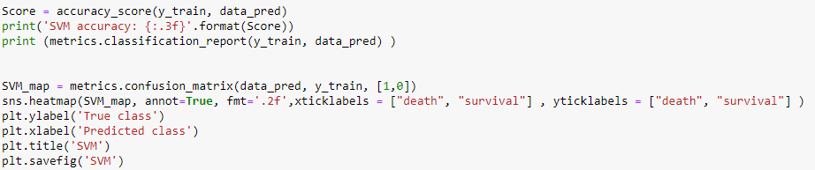
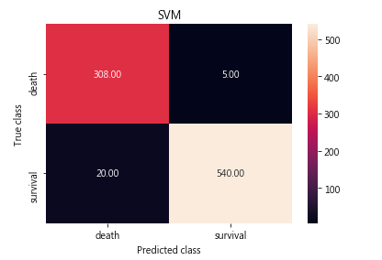
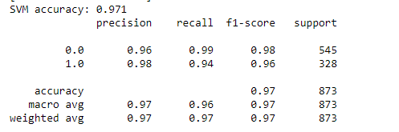
Predict the Survival(1/2)
Report the classification and draw the confusion matrix

Slide 22

Output File(.csv)
Output the survival result you predict.
You can choose the best result under different models.

Slide 23
appendix

Slide 24
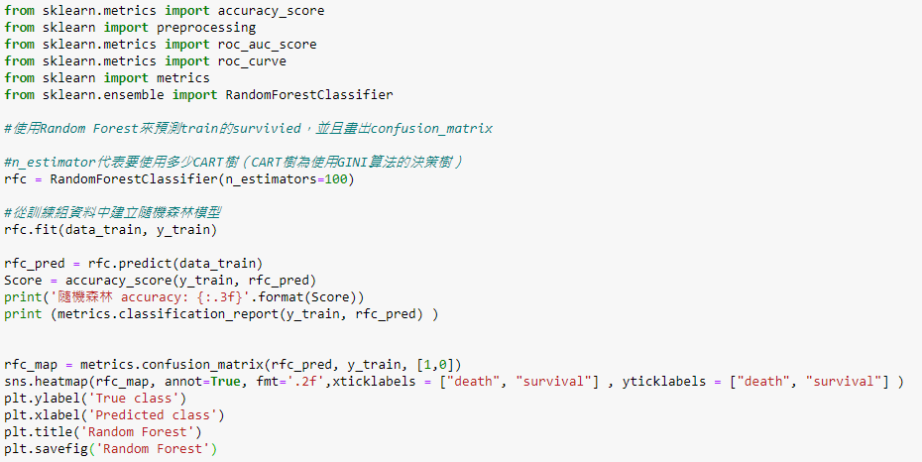
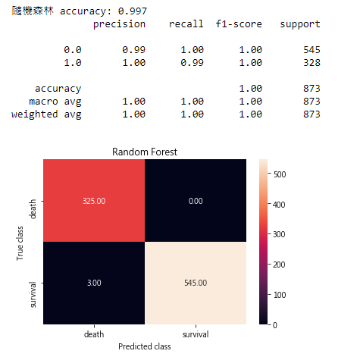
Other Models(1/2)
Random Forest

Slide 25
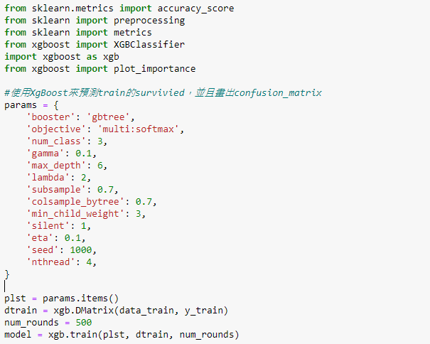
Other Models(2/3)
XgBoost

Slide 26
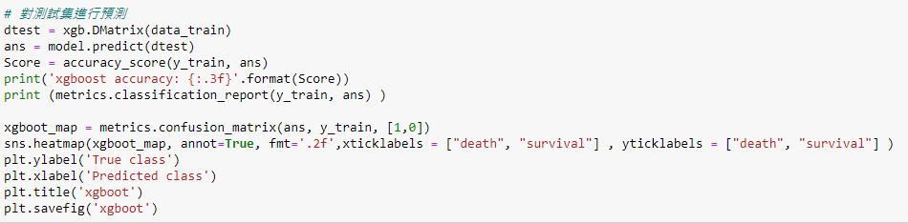
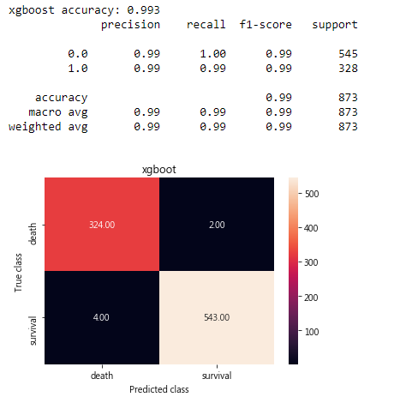
Other Models(3/3)
XgBoost

